Slide 1

Fairness/Complexity Trade-Off
Slides prepared by Makan Arastuie
EECS 6980 - Probabilistic Methods in Data Science Course Project
04/18/2018
Background slides are influenced by the NIPS 2017 Tutorial on Fairness in Machine Learning

Slide 2
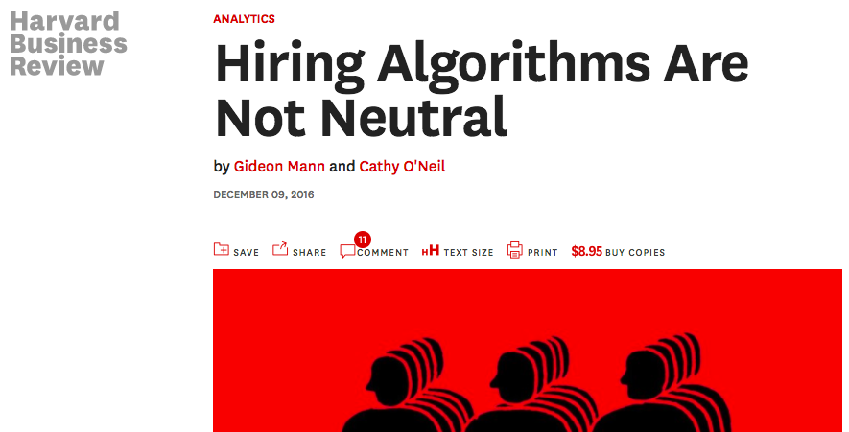
Why fairness matters in AI?
“These software systems can in some cases be so efficient at screening resumes and evaluating personality tests that 72% of resumes are weeded out before a human ever sees them.”
– Gideon & Cathy

Slide 3

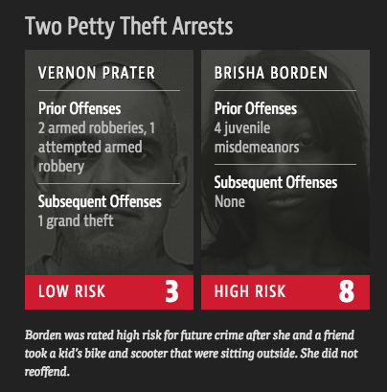
Why fairness matters in AI?
“The formula was particularly likely to falsely flag black defendants as future criminals, wrongly labeling them this way at almost twice the rate as white defendants.”
“White defendants were mislabeled as low risk more often than black defendants.”

Slide 4
Why fairness matters in AI?

Slide 5
Isn’t discrimination the very point of ML?
Unjustified basis for differentiation
Practical irrelevance
Moral irrelevance

Slide 6
Discrimination is not a general concept
It is domain specific
Concerned with important opportunities that affect people’s life chances.
Some of the current regulated domains in the U.S. include:
Credit, Education, Employment, Housing, “Public Accommodation”
It is feature specific
Concerned with socially salient qualities that have served as the basis for unjustified and systematically adverse treatment in the past.
Some of the legally recognized ‘protected classes’ in U.S. include:
Race, Color, Sex, Religion, National Origin, Citizenship, Age, Pregnancy, Familial status, Disability status, Veteran status, Genetic information

Slide 7
Two doctrines in discrimination law
Disparate Treatment
Disparate Impact
Formal:
Explicitly considering class membership
Even if it is relevant
Or
Intentional:
Purposefully attempting to discriminate without direct reference to class membership
Pretext or ‘motivating factor’
---------------------------------------------
We aim to achieve:
Procedural fairness
Equality of opportunity
Unjustified or avoidable
Legal procedure:
Establish that decision procedure has a disparate impact (‘Four-fifths rule’)
Provide a justification for making decisions in this way (‘Business necessity’ and 'job-related’)
Show that defendant could achieve same goal using a different procedure that would result in a smaller disparity (‘Alternative practice’)
----------------------------------------------
We aim to achieve:
Distributive justice
Minimized inequality of outcome

Slide 8
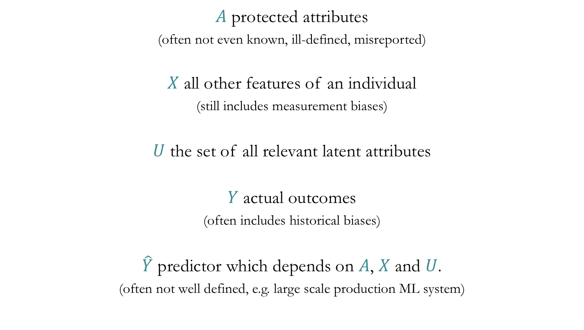
Formal setup
$A$ protected attributes
(often not even known, ill-defined, misreported)
$X$ all other features of an individual
(still includes measurement biases)
$U$ the set of all relevant latent attributes
$Y$ actual outcomes
(often includes historical biases)
$\hat{Y}$ predictor which depends on $A$, $X$ and $U$.
(often not well defined, e.g. large scale production ML system)

Slide 9

Demographic parity
Assume $Y$ and $A$ are binary variables.
Definition. Classifier $\hat{Y}$ satisfies demographic parity if:
$$P\left(\hat{Y} | A=0\right)=P(\hat{Y}|A=1)$$
In another words, membership in a protected class should have no correlation with the decision.

Slide 10
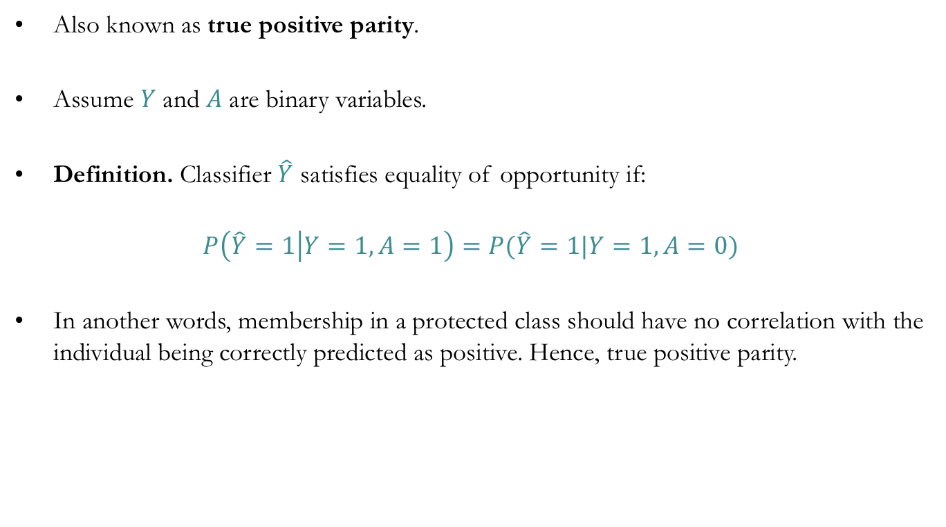
Equality of opportunity
Also known as true positive parity.
Assume $Y$ and $A$ are binary variables.
Definition. Classifier $\hat{Y}$ satisfies equality of opportunity if:
$$P\left(\hat{Y}=1 | Y=1, A=1\right)=P(\hat{Y}=1|Y=1,A=0)$$
In another words, membership in a protected class should have no correlation with the individual being correctly predicted as positive. Hence, true positive parity.

Slide 11
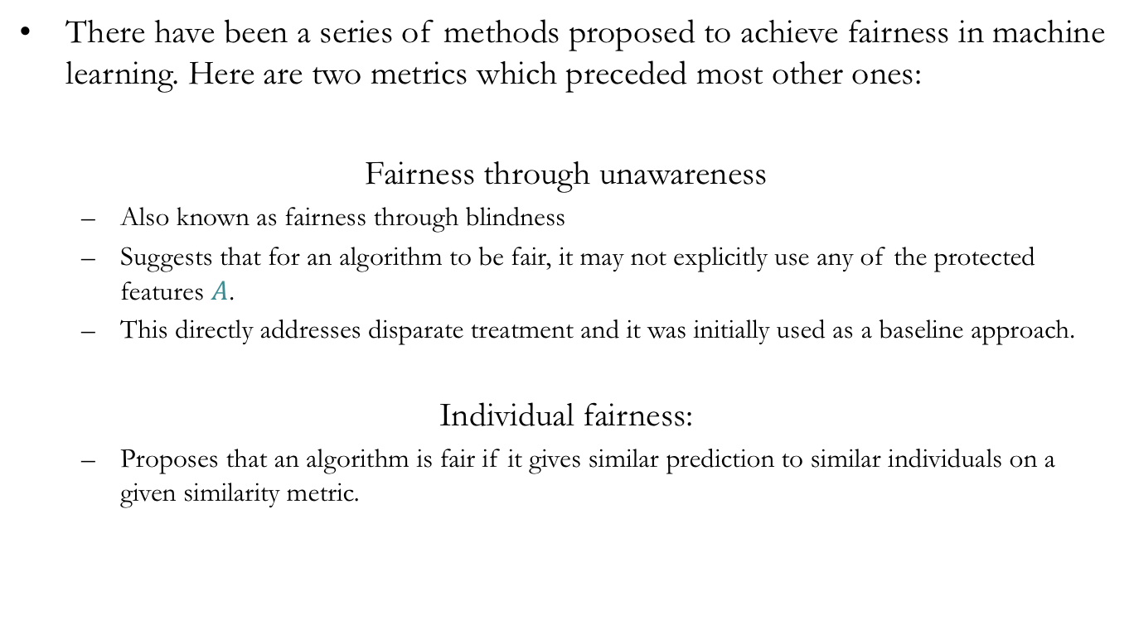
Methods to achieve fairness
There have been a series of methods proposed to achieve fairness in machine learning. Here are two metrics which preceded most other ones:
Fairness through unawareness
Also known as fairness through blindness
Suggests that for an algorithm to be fair, it may not explicitly use any of the protected features $A$.
This directly addresses disparate treatment and it was initially used as a baseline approach.
Individual fairness:
Proposes that an algorithm is fair if it gives similar prediction to similar individuals on a given similarity metric.

Slide 12
Fairness/complexity trade-off
Our objective in this study to analyze the trade-off between the complexity of machine learning algorithms which in general achieve a higher accuracy vs. the fairness they are able to achieve.
We are interested to see if the higher accuracy caused by a the overall higher complexity of an algorithm is due to sacrificing fairness in the prediction.
In order to do so we:
Familiarize ourselves with the dataset at hand and decide which features we do not want to discriminate against.
Fit various machine learning algorithms to the dataset and evaluate its fairness with respect to our protected features.
Evaluate how much fairness was lost due to increase in accuracy and see if there is a correlation between the two. If not, we are interested to know if there is a common characteristic which causes decrease in overall fairness.

Slide 13
UCI Adult dataset
Abstract: predict whether income exceeds $50K/year based on census data.
Also known as "Census Income" dataset.
14 features including:
Age, work class, education, marital status, occupation, race, sex, capital gain and loss, native country, etc.
Selected protected features:
Age, race, sex and native country.
Also, this dataset has a predefined train and test split of 2/3 and 1/3 respectively. We utilized the original split throughout our analysis.

Slide 14
UCI Adult dataset (cont.)

Slide 15
UCI Adult dataset (cont.)

Slide 16
UCI Adult dataset (cont.)

Slide 17
UCI Adult dataset (cont.)

Slide 18
Machine learning methods
The next step of the project is to fit different machine learning algorithms to the UCI adult dataset and evaluate fairness with respect to the protected features.
The fairness measures are:
Demographic parity
Equality of opportunity

Slide 19
Decision trees
Decision tree algorithm was chosen since:
It is a relatively transparent model.
The intuition behind how it works is well known.
Setup and parameters were selected as follows:
Split function (aka criterion): entropy
Max depth: 3 (this was chosen to be limited to further simplify the model)
Features were considered as given by the dataset with no preprocessing
The default test and train split of the dataset was used.

Slide 20
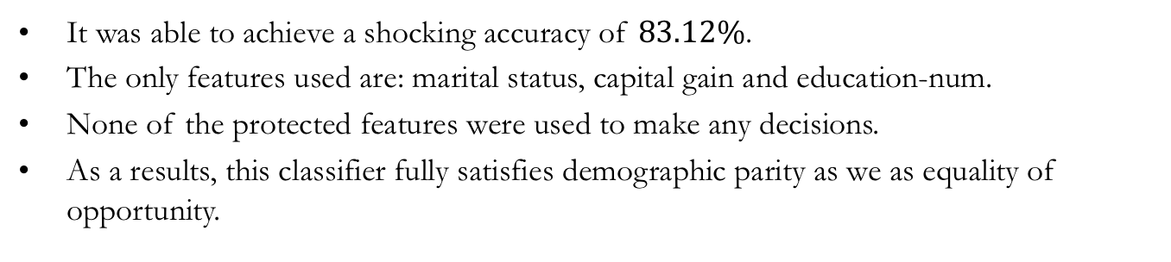
Decision tree results
It was able to achieve a shocking accuracy of $83.12\%$.
The only features used are: marital status, capital gain and education-num.
None of the protected features were used to make any decisions.
As a results, this classifier fully satisfies demographic parity as we as equality of opportunity.

Slide 21
Decision tree results (cont.)
Although this classifier satisfied demographic and true positive parity based on our protected features, false positive and false negative rates vary between groups:
This variation in FP and FN rates also exists amongst the groups of other protected features.
This disparity suggests that achieving demographic parity and equality of opportunity, does not guarantee fairness overall.

Slide 22
Random forest
Random forest was chosen next since, although the intuition behind it is still fairly understandable, the stochastic nature of it, as well as the depth, definitely makes it more complex compared to a basic decision tree with a max depth of 3.
Setup and parameters were selected as follows:
Split function (aka criterion): gini
Number of trees in the forest: 50
Max depth: 14 (number of features)
Features were considered as given by the dataset with no preprocessing
The default test and train split of the dataset was used.

Slide 23
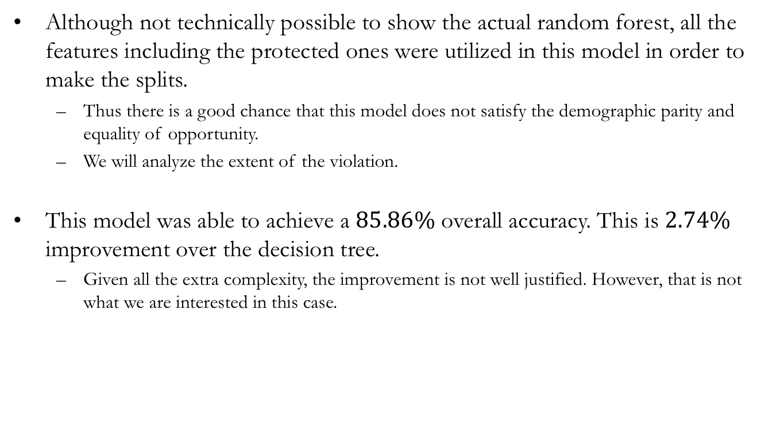
Random forest result
Although not technically possible to show the actual random forest, all the features including the protected ones were utilized in this model in order to make the splits.
Thus there is a good chance that this model does not satisfy the demographic parity and equality of opportunity.
We will analyze the extent of the violation.
This model was able to achieve a $85.86\%$ overall accuracy. This is $2.74\%$ improvement over the decision tree.
Given all the extra complexity, the improvement is not well justified. However, that is not what we are interested in this case.

Slide 24
Random forest result (cont.)

Slide 25
Random forest result (cont.)

Slide 26
Work still in progress
As it was shown by the comparison between decision tree and random forest, “learning the data better” by increasing the complexity of the algorithm and striving for a higher accuracy may cause unfairness.
For this observation to be generalizable, we will be modeling the UCI Adult dataset with other machine learning algorithms with different characteristics.
Given all the results, we are interested to know whether or not increasing the complexity of the model to achieve a higher accuracy will cause more unfairness or if it is possible to reasonably increase the accuracy without sacrificing fairness.

Slide 27
Why this matters?
It is true that if fairness in prediction is the number one priority, it is better to design a fair machine learning algorithm with that goal in mind.
However, it is crucial to understand how most commonly used machine learning algorithms will perform with respect to fairness, since in most practical situations people will not bear the burden of implementing a complex and not well defined algorithm like individual fairness.
Thus, as future study we can find small and easy to implement changes within the popular machine learning algorithms that can increase the fairness of those models.

Slide 28


